Slide 1
CS112 : Introduction to Python Programming
Week 3: lab practice

Slide 2
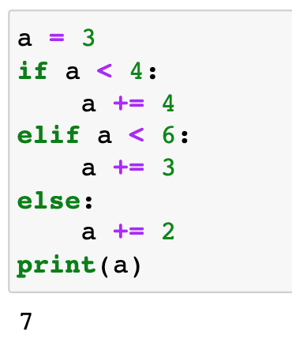
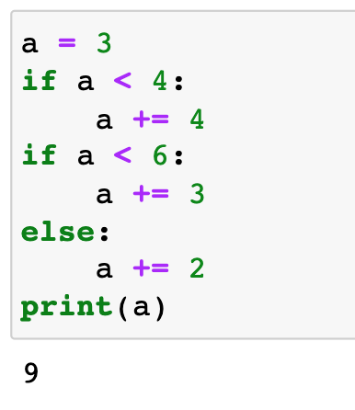
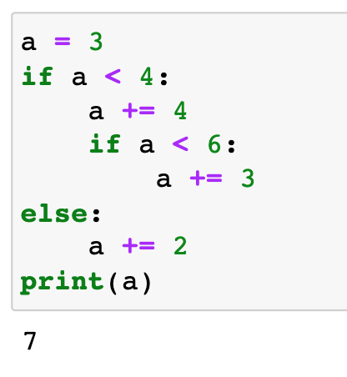
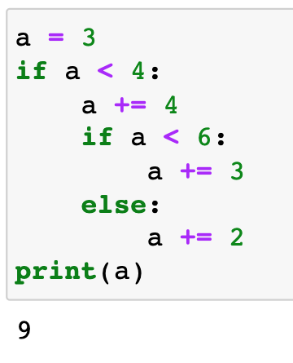
Practice 1
A): 5
B): 7
C): 9
D): 10
E): None of the above
A): 5
B): 7
C): 9
D): 10
E): None of the above
A): 5
B): 7
C): 9
D): 10
E): None of the above
A): 5
B): 7
C): 9
D): 10
E): None of the above

Slide 3
Practice 2
Write a program to check if the absolute value of a number is larger than 5. Take input from the user and print in the following format:
The absolute value of number [XXX] is/is not larger than 5
e.g.
input: -6
output: The absolute value of number -6 is larger than 5

Slide 4
Practice 3
Write a program to check if a number is divisible by both 5 and 7. Take an int input from the user and print in the following format:
Number [XXX] is / is not divisible by both 5 and 7
e.g.
input: 35
output: Number 35 is divisible by both 5 and 7
input: 10
output: Number 10 is divisible by 5 but not by 7
input: 14
output: Number 14 is divisible by 7 but not by 5
input: 18
Number 18 is not divisible by 7 nor by 5

Slide 5
Practice 4
Write a program to print the grade for a score between 0.0 and 100.0. If the score is out of range, print an error：
Score | Grade
≥ 90 | A
≥ 80 | B
≥ 70 | C
≥ 60 | D
< 60 | F

Slide 6
Practice 5
Write a program that takes a string as input and counts the number of uppercase letters in the string.Write a program to answer:

Slide 7
Practice 6
求100以内的奇数.

Slide 8
Practice 7
Write a program to check if a year is a leap year (闰年) or not
闰年：
（1）四年一闰百年不闰：即如果year能够被4整除，但是不能被100整除，则year是闰年。
（2）每四百年再一闰：如果year能够被400整除，则year是闰年。

Slide 9
Practice 8
本金1万元，年利息3%，存5年后，本息合计是多少？

